Slide 1


Arduino Class Programming with Examples
Part 1: Introduction
Alan Lomax
M8640
Notes:
MERG presentation (presented in two parts) for the Arduino SIG.
Prepared 2nd half of 2021. Presented January 2022.

Slide 2

About Me
Alan Lomax
calls Ontario, Canada his home
Notes:
Introductions – a little bit about myself!
Recently Retired Electrical Engineer
Petrochemicals – first in maintenance and then doing Automation upgrade Projects
Technically – Networking plus Hardware and Software Integration. Focus was always control systems, safety shutdown systems and fault tolerant design.
Abnormal Situation Management – Ergonomic Factors
For the last few years I am back into model railways beginning with a rip and replace control system project!
Have been in MERG for less than a year … this is my first presentation (go easy!) … And.. I am not a professional programmer!

Slide 3

Introduction
Notes:
Introductions – a little bit about myself!
Train connections run deep in the family.
Living in Canada now but I was born in Widnes where my maternal Grandad drove (heavy freight) steam engines for his whole life.
Picture is of me on a class 8F – probably scared to death at being so high up.

Slide 4
Agenda
Motivation
Ground Work – Types and Structures
Basic Concepts - What is a Class ? How does it work?
Sample Code Fragments
Making the case: Why use a Class?
Questions
Notes:
Classes are a fundamental part of Object Oriented Programming and we will be covering this topic in two parts.
- In this first part … develop the general concepts … look at some code fragments to understand how it works …
- In a second presentation I will go through a complete example … with some live demos of class programming.
- Agenda Review above

Slide 5
Motivation
Part 1
Back to Agenda

Slide 6

Turntable
Stop
LCD
Speed
Control
12 VDC Power
Switch
Home
I2C
AI
CCW
Arduino NANO R3
On a Shield
Motor Shield
AI
CW
DO x 4
FLIP
DO x 3
DI
DI
DI
Hall Effect #1
Hall Effect #2
Hall Effect #3
Turntable
LED #1
LED #2
LED #3
12 VDC Motor
Magnet on Bridge
Notes:
This Slide builds up in steps .. .talk about each item as it appears.
The final software for this did not just appear to me in a vision … there were many iterations of it and countless problems to be solved along the way.
As the code got bigger it became more difficult to maintain (more importantly difficult to understand) .. If I left it for a few days it was difficult to get back immersed in it.
I had read about class programming, and I know that I had used software classes … but now it was time to write my own!
Initially It was a self assigned study … told myself “I am going to learn this!” …. Which very quickly became “Wow .. This is so much easier”
My objective here … is to make the case for using Class programming in certain situations
And hopefully take a lot of the mystery out of it.

Slide 7
Turntable SW Classes and Usage
Software LED object allow for blinking LED’s without using delay().
Can set on time, off time, read the current state and turn on or off.
LED
Button
Treat button inputs as a software object. Debounce without delay()
Motor
Treat motor as a software object. Stop, start, speed and direction
A general purpose timer class. Monitor an input, Set both ‘on delay’ and ‘off delay’ values. Can read the output property as to whether it is on or off. Again no delay() function.
DblDelay
Treat LCD display as a software object. Using the data sheet I implemented each command it could understand. Then I combined some of these to make up new and more powerful commands. (simplifying the sketch)
LCD
Notes:
So what classes do I end up creating.?
Talk them through – very high level. Each one evolved to fill a need.
There a few themes that might already be apparent to you.
None of the above is a complete program … but each is like a ‘LEGO BRICK’ which we can use to build something bigger
No calls to delay() (say a few words what delay() does) LED blinking example
Complexity can be hidden inside these LEGO BRICKS and it is not necessary to see that complexity to use the bricks.

Slide 8
Delay() and What is The Big Deal?
Software LED object allow for blinking LED’s without using delay().
Can set on time, off time, read the current state and turn on or off.
LED
// Standard LED Blink Example Code
void loop() {
digitalWrite(LED_BUILTIN, HIGH); // turn the LED on (HIGH is the voltage level)
delay(1000); // wait for a second
digitalWrite(LED_BUILTIN, LOW); // turn the LED off by making the voltage LOW
delay(1000); // wait for a second
}
Notes:
First line is from previous page – the class does not use delay() … so what?
Next shows LED blink example which is part of the Arduino IDE (Basic Examples)
Say a few words what delay(1000) does – soaks up CPU cycles for one second. (1000 ms)
The loop is not looping – so our sketch cannot monitor sensors or buttons blinking LED’s and controlling our motor
In order to do those things continuously we need to find ways of not using delay()
And that is what I am referring to.

Slide 9
Ground Work - Types and Structures
Part 2
Back to Agenda

Slide 10

Ground Work
Variable Types
int for Integer
bool for Boolean
string for textual data
float for floating point numbers
(and others)
Underneath all of these it is just bits and bytes of binary code.
When we declare a type we are describing how to interpret the binary
This is ‘bread and butter’ for programming in Arduino (and C++)
int x = 5; // normally a 16 bit integer
bool isPlaying = false; // a Boolean is true/false
string fname = “Fred”; // a string represents text
Notes:
These are fundamentals to build on. Part of this is getting us familiar with the vocabulary.
Later when I talk about a variable Type … I want everyone to know what that I am referring to.

Slide 11
Types and Structures
Struct{} (short for structure)
It is possible (and not uncommon) to define our own variable type which is a combination of the basic types given previously. A simple example:
struct structname {
String fname;
String lname;
};
structname fullName;// Declare a new variable of the new type
int x; // for comparison using a simple type
After defining the variable you can pass around the whole structure
as fullName or refer to the individual component parts like this:
fullName.fname = “Fred”;
fullName.lname = “Flintstone”;
Notes:
Structures are commonly used to handle related data as though it were a single item.
Not restricted to just two strings as shown .. Could be int, float etc. One structure could have many different component parts.

Slide 12
Types and Structures
The structure is not restricted to basic data types.
The structure could include complete functions that manipulate data also.
struct structname {
String fname;
String lname;
int fnameLength() {
return fname.length();
};
};
Notes:
This is a trivial example (and not that clever) .. But it illustrates the point.

Slide 13
Types and Structures
In a recent MERG Arduino SIG meeting Chris Sharp gave a presentation on structures and in particular he was focusing on a Servo structure he designed.
As the concept of structures was introduced it became clear that at a high level the code would be easier to maintain and develop further.
But also the ‘code complexity’ was still in plain view.
(It was in essence a reorganizing of existing code.)
Notes:
Next page shows Chris using color coding to show at a high level how blocks of code were moved around.

Slide 14
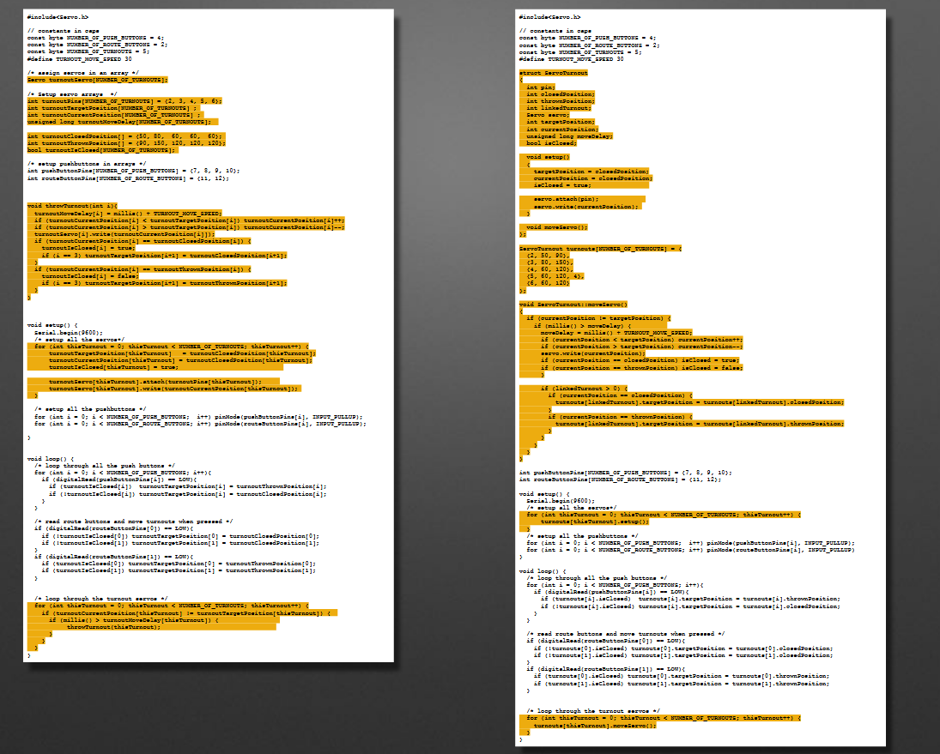
Types and Structures
Chris provided this picture emphasizing the reorganizing.
Notes:
You may recall Chris using color coding as shown.
The essence was at a high level how blocks of code were moved around but fundamentally they were in plain view still.
When I say plain view … the inner workings of the structure was still there to see in plain sight
The sketch code was not a lot shorter or really significantly easier to comprehend.
It was a lot more modular and thus easier to grow and adapt.

Slide 15
Basic Concepts - What is a Class ? - How does it work?
Part 3
Back to Agenda
Notes:
OK Enough with the ground work … let’s move on

Slide 16
New Concept: A software Class
Very similar to a struct{ } a Class can be thought of as a user defined type but the big difference is it hides the implementation details.
This also means it hides complexity. To use a class you don’t need to know the implementation details. Most of the time you don’t want to – you have a sketch to write!
But we are MERG Arduino SIG and we want to know!
All of this to be covered …. So lets go!
Notes:
Using a class means you interact with it according to the authors wishes only.
Being able to look into a class and with what we are about to cover you can download and Inspect other peoples ‘classes’ and use them with confidence.
You can write your own classes.

Slide 17
Original to Struct{} to Class{}
Original Code
Code with struct{}
Code with class{}
Original code before struct{}
Reorganized
Code (Streamlined)
Reorganized
Code (Streamlined)
struct{}
class {}
Functions inside struct{}
Functions inside class{}
Notes:
Here we are showing how the code changes as we use structures .. .and then classes.
Start with high level view (I like using pictures!).
Starting with original code – messy, (the colour bars represent different functions in the program). It is one big ‘space’ where as the programmer you had to be very concerned about keeping track of variable names and what part of the program they applied to. The logic for all the parts was generally mixed together.
After reorganizing the code is streamlined. Slightly easier to comprehend. Overall though the program complexity is still in plain view.
With a class definition all of the ‘complexity’ is hidden from view inside the class. To use the class we may not even be aware of its internal functions.
The code for the class can be (and commonly is) kept in separate source files.
Once the class software is developed it is saved away and is easily reused in multiple programs. Because the class code is in separate files sharing and reusing these as ‘building blocks’ is much easier.

Slide 18
A Software Class
on
output
off
Led2
Class Definition
Complex Stuff
Led2 myLed1 = Led2(13);
int pin = 13; // for comparison
Led2 myLed1 = Led2(13);
Led2 myLed2 = Led2(9);
Led2 myLed3 = Led2(8);
Member functions.
Led2 myLed1 = Led2(13);
Pin 8
Objects:
myLed1
myLed2
myLed3
Pin 9
Pin 13
Notes:
The blue box is my ‘shoebox’. Complexity may be hidden inside the shoebox (But as a user we don’t care)
Sticking out of the shoebox are three items .. Two inputs and one output (this is not hardware recall).
Terminology. on and off are called member functions. As we will see later inside the class definition there are software functions that implements these. And so the functions are ‘members of the class’.
Sven has pointed out to me that writing the definition as "Led2 myLed1 = Led2(13);“ makes it easier to see the relationship with definition of a normal variable like "int pin = 13;" which you are familiar with. Here is where it is useful to think of Led2 as a type.
Do not be confused by the objects … they could be called anything we like … myLed1 .. myLed2 … myLed3 are just my arbitrary names.
Side notes …
On and Off do not make a compelling case but were working up to that.
The class is called Led2 because it was my second go at it and for a time I had two Led classes kicking around.
The colour coding (blue, green, red) I have added to the slides for emphasis and learning … do not expect to see these in your Arduino IDE !

Slide 19
Led2 is just an Example (We could be talking about a servo class)
Attach
Output Pin
Detach
Servo
Class Definition
Write
Output Pin
Output Pin
Objects:
myServo1
myServo2
myServo3
Output Pin
Notes:
The Picture hardly changes.

Slide 20
Sample Code Fragments
Part 4
Back to Agenda
Notes:
On the next few slides we will take a peek at some of the code fragments that will give you some insight as to how the class software is written.
I do need to emphasize though … these are just code fragments not complete solutions. We will get to the complete solution in part 2 of this talk.

Slide 21
A little Deeper: The Constructor
on
output
off
Led2
Class Definition
Complex Stuff
Led2 myLed1 = Led2(13);
on
Pin 13
off
myLed1
Complex Stuff
Notes:
This code line is calling a special function in the class called the constructor.
Why is it called that ? .. Not surprisingly because it will construct the object for us
What does that mean really? – talk it through … use an Americanism – the Cookie Cutter … (or Pastry Cutter)
Writing the class software is defining the pastry cutter shape. Using the class software is using that pastry cutter to stamp out all of those mince pies you just ate!
For a given object you would only call the constructor once, after which the object can be said to exist.

Slide 22
First Look - Class Program Code
class Led2 {
private:
int _pin; // the number of the LED pin
unsigned long _onTime; // milliseconds of on-time
unsigned long _offTime; // milliseconds of off-time
unsigned long _nextTime; // next time change in milliseconds
bool _blink; // true if we are in blinking mode, false if not
{ snip }
public:
Led2(byte pin); // Simple default definition
void off(); // Turn off the LED
void on(); // Turn on the LED
void update(); // Magic Sauce
{ snip }
}
Notes:
This code is part of the actual class definition we will be looking at (I have snipped out parts while I Introduce the terminology)
class class name c/w curly braces just like in a structure.
Some variables are declared private .. What does that mean? They are Inside the shoebox (class) and not available to the outside.
Very important concept here … every time we create a new object it will get its own set of these internal variables
The variable names wont conflict and they survive as long as the object sticks around.
My naming convention .. Private variables start with an underscore .. Helps me keep it clear.
Public variables – are what is visible to us outside the shoebox.
You should recognize the constructor, and the other member functions off() and on()

Slide 23
A peek Under the Covers : The Constructor
output
Led2 Class
myLed1
_pin = 13
Led2 myLed1 = Led2(13);
Led2::Led2(byte pin) {
_pin = pin; // Save the passed pin
pinMode(_pin, OUTPUT); // define our output pin
off(); // call the off function
}
Notes:
The first line is what we would have in our sketch … it calls the constructor to make our new object
The second line is what happens inside the shoebox .. .the code that implements the constructor.
Key point – every time we call the constructor a ‘new’ object is created and all of the internal class variables for that object are kept separate
The double colon is called the ‘scope resolution’ operator. Here it is letting the compiler know that the function Led2(byte pin) is within the scope of the class Led2.
Notice the constructor has the same name as the class .. And it does not return a type.
Recall the meaning of the leading underscore which in this case is trivial. (Sometimes we might do validity checking before saving it.)
I hope people are underwhelmed with this … When we call the constructor it will set aside memory locations for the private variables and if we tell it to it will assign values to them.
In this case we are setting _pin and then using the standard Arduino function called pinMode. Note we have not actually sett the output to a value (yet).

Slide 24
A peek Under the Covers : the on() property
output
myLed1
“on” Command
_pin = 13
_blink = false
_state = HIGH
myLed1.on(); // Outside the shoebox set the on property of myLed1 object
void Led2::on() {
_blink = false; // Turn off blink mode
_state = HIGH; // Set desired state LED
}
Notes:
Again I hope people are underwhelmed with this … the on property is just setting private internal values.
Inside the shoebox on() is a function that sets the private internal variable _state and _blink
I probably could have just made _state a public variable (not private) and then we could write to it directly.
Generally doing this is a poor idea as doing so does not allow the possibility of error checking and users could enter values you are not expecting.
I think it is better to have a function .. (which might have a value passed to it)
The function can do error checking and only then set the private variable.

Slide 25
The Magic Sauce: the update() method
output
_pin = 13
_blink = false
_state = HIGH
myLed1
“update” method
myLed1.update(); // update the myLed1 object
void Led2::update() {
}
digitalWrite(_pin, _state); // update the actual output according to desired state
if (_blink) { // If in blinking mode look at timing first
}
if ( millis() >= _nextTime) { // It is time to do something.
}
_state = !_state; // swap states
_nextTime = millis() + (_state == HIGH ? _onTime : _offTime); // and calculate when next
// change of state is due
Notes:
Terminology first …. Property vs Method … often misused and yes I do fall into this trap.
Basically an object property is something that has a value. The value can be set (written to) or read (obtained from) the object.
Compare this to a method which just does something. Note the update method above has a return type of ‘void’ (you don’t read its value) and also did not need any passed parameter (you don’t set a value).
Within the class properties and methods can both be implemented as functions. In some other languages the compiler can help with get and set of properties but not with the Arduino.
The update method is where it all happens. In our main sketch we would call the update method for each object frequently (in your loop code)
Lets go through what update is doing …
Talk it through as text box builds up in several stages.
Be sure to differentiate between the class definition (the pastry cutter) and the specific object (the mince pie)
(ignore the calculation of _nextTime until last just to avoid confusing things) - it uses conditional evaluation

Slide 26
A Simple Complete Sketch
#include “Led2.h”
Led2 myLed1 = Led2(13);
void setup() {
myLed1.onTime(50); // Set LED onTime (50 ms)
myLed1.offTime(300); // Set LED offTime (300 ms)
myLed1.blink(); // turn on blink mode
}
void loop()
{
myLed1.update(); // call update frequently
}
Notes:
This is a complete working sketch.
In part two we will spend time to go through this and take a look at the code inside the shoebox (including other properties not shown)
The above is actually a bit of a tease because so far we did not talk about setting the onTime or the offTime as shown.
Main reason for showing this now is to emphasize the point that using an object oriented approach simplifies your code
The nitty gritty internal workings (the complex stuff) is hidden inside the class and the objects we create … but we don’t need to know how they work unless we want to
Hopefully you will agree that our ability to comprehend what this sketch does is much simplified. We do not need to know about millis … and time delays
Also you should see that I can create as many objects as I need .. Using different pins for outputs ..
The blink rate of them all is quite independent and does not block or hang up the loop code in any way.
The loop code could easily be calling the update method on 3 different LED’s plus a Servo to boot (taking just 4 lines of loop code)

Slide 27
Why use a Class?
Part 5
Back to Agenda
Notes:
Getting near the end … making my case.

Slide 28
Why use a Class?
Comprehension: Since the details are hidden the overall operation of the code is much easier to understand.
Productivity: Defining and using new objects using an existing class can be very quick.
Portability: The same class can be used in many sketches. (Depending on where the class code is stored.)
Testability: Testing and debugging is very compartmentalized. The many small functions that make up a class are independent.
Inheritance: We have not talked about it but new classes can build on and expand other classes bringing forward all of the properties and methods of the original class.
Notes:
Talk to each line one at a time
There may be others but I cant think of them.

Slide 29
Why Not use a Class?
Creating the class definition does require some effort.
For simple applications you may not need a class so why complicate things any more than needed?
All that hidden complexity might represent a can of worms Especially if you did not write the code but still have a need to dig into it.
Using a class still has a learning curve. This is especially true if a class has lots of properties and methods having many options.
Changing a class can have knock on effects to many programs that depend on it working in a certain way.
Notes:
In the interest of a balance there are reasons not to use classes (object oriented programming)
Classes are still programs and programs can have bugs in them.

Slide 30
The Key Points
#1: The object is defined by the class but it is a separate entity.
You do not need to know the inner workings of the class definition in order to use it.
#2: Even though each object gets its functionality from the class definition, each is independent. When writing class code the variables you use inside the class can be thought of as generic … and only when you define an object do they become specific.
#3: The Reusability of class code without exposing complexity makes for huge coding efficiency.
#4: There is no such thing as magic!
Notes:
Slide builds up.
The last point … is to emphasize that nobody is born knowing this stuff.
It is all learned and if you are curious enough and ask enough questions it you can do it.

Slide 31
Recap
Variable Types including creating a struct{} as a custom variable type
Creating a Class{} is also defining a custom variable type. There can be private and public aspects (These can be member variables or member functions)
We looked at some code fragments to hopefully get a good feel for what is going on inside the shoebox. The constructor function creates our objects. Other member functions allow us to interact with it.
Reusability of a class without exposing the complexity makes for coding efficiency. Applies to both writing the code, comprehending the code, and maintaining the code.
Notes:
Wrapping it up

Slide 32
Questions?
Part 6
Some Backup Material Follows
Back to Agenda

Slide 33
Backup Material

Slide 34
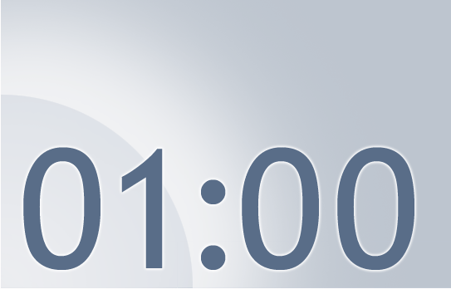






The Next Train Departs in:
Notes:
Move this slide up in the deck to wherever I want to take a 5 minute break.
Using this PowerPoint break timer
This PowerPoint slide uses images, custom animation, and timing to provide a countdown timer that you can use in any presentation. When you open the template, you’ll notice that the timer is set at 00:00. However, when you start the slide show, the timer will start at the correct time and count down by 1-minute intervals until it gets to 1 minute. At that point, it will count down in two 30-seconds intervals to 00:00.

Slide 35
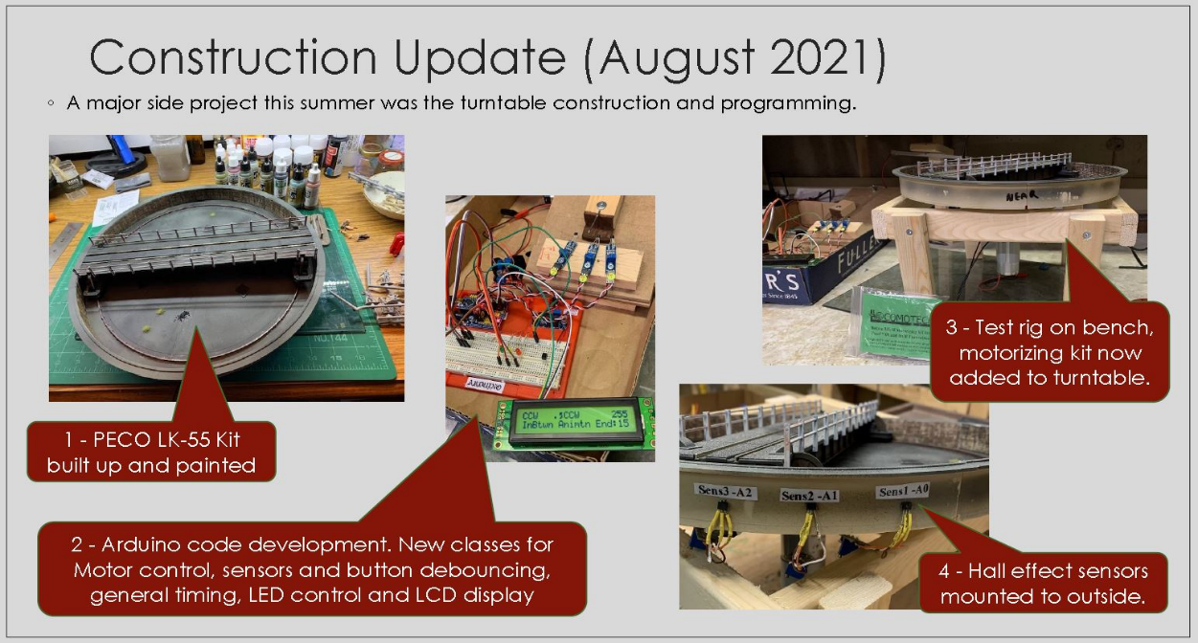
My Motivation
Notes:
Show people that this can be about modelling on railways.
It is not just deep in the weeds Arduino programming.

Slide 36
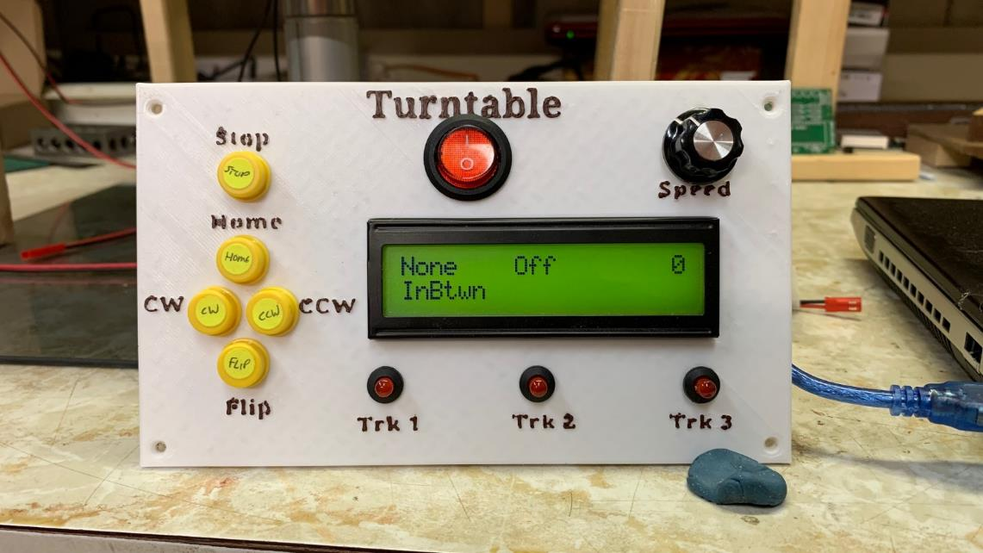
My Motivation
Notes:
User interface – 5 buttons .. One speed control potentiometer one LCD screen (With 6 separate data regions showing 6 status items) 3 LED’s for when turntable bridge is in a specific position.
Other Inputs – 3 HALL effect sensors on outside of turntable well … detect micro magnets attached to each end of the bridge as it rotates.
Other outputs – DC motor control direction and speed control.
Logic – depending on button press move in the correct direction until hall effect sensor is detected.
All controlled by one Arduino NANO.

Slide 37
References and Additional Material
Binary numbers and types :
https://learn.sparkfun.com/tutorials/data-types-in-arduino/all
http://users.ece.utexas.edu/~valvano/embed/chap3/chap3.htm
Conditional Evaluation (ternary operator):
https://www.tutorialspoint.com/cplusplus/cpp_conditional_operator.htm
Alternate explanations on subject of Classes:
https://www.guru99.com/cpp-classes-objects.html
http://mypractic.com/lesson-7-classes-in-c-language-for-arduino-button-as-an-object/
https://www.geeksforgeeks.org/c-classes-and-objects/
http://paulmurraycbr.github.io/ArduinoTheOOWay.html

